Slide 1



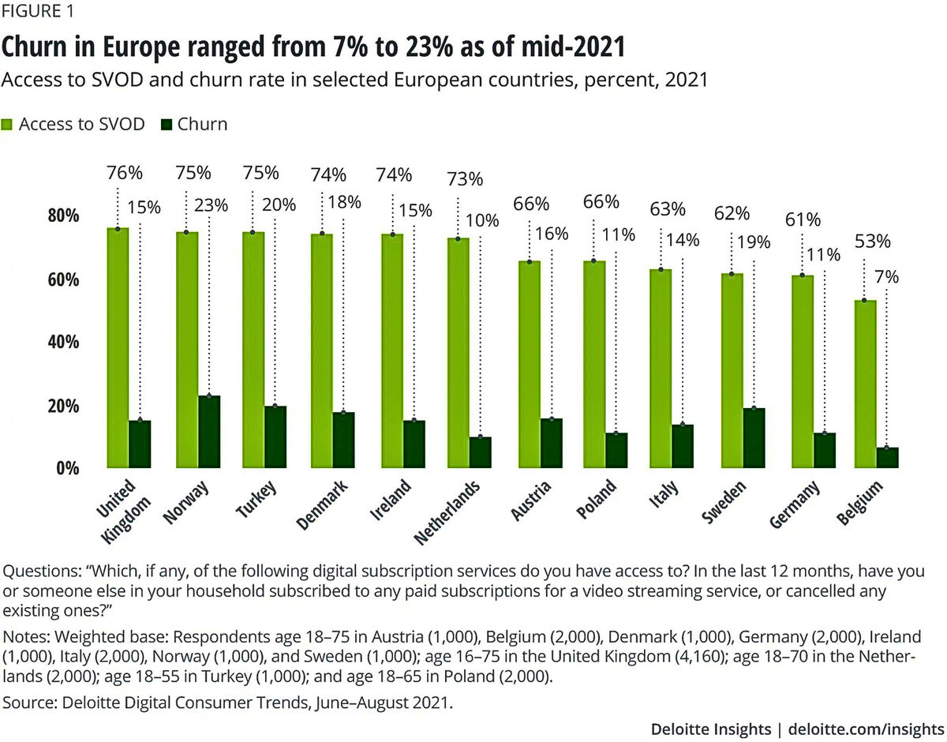
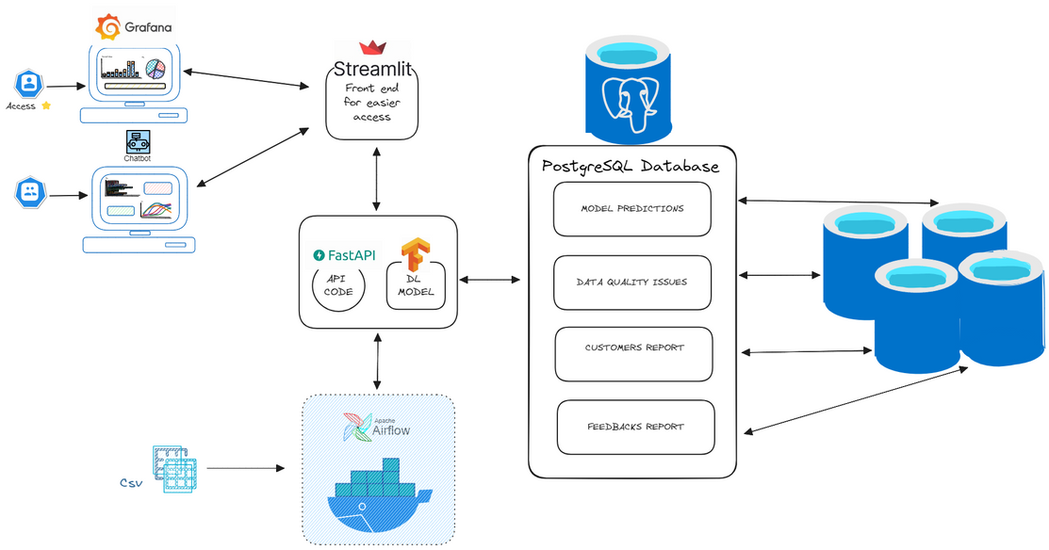







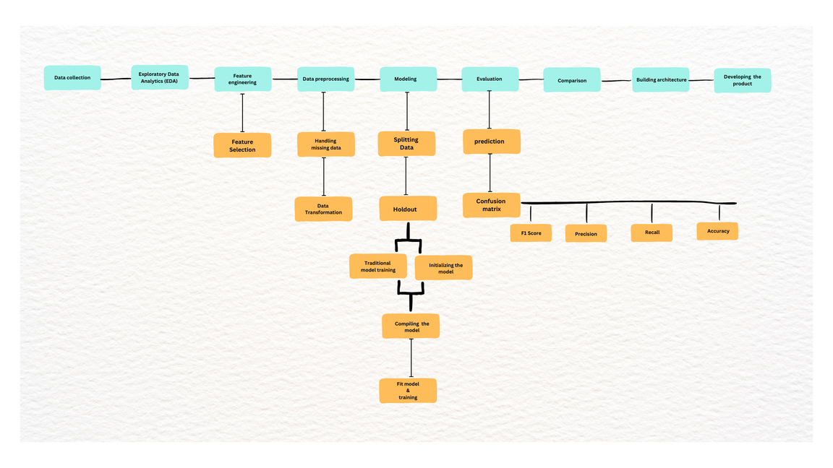
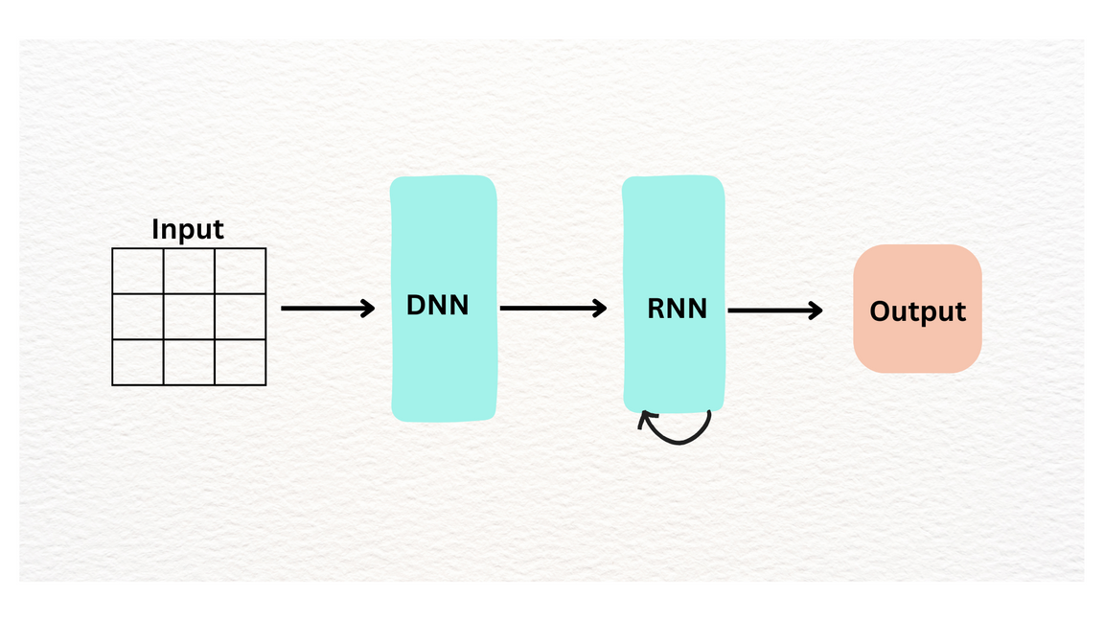
Telecommunication Customers Churn Prediction
Duong Khanh Tran I Shashank Vaidya I Johnfredrick Ebikemefa Owotorufa
Data Science & Analytics, 2023
PROJECT DESCRIPTION
CHURN IN EUROPE - 7% TO 23% (2022)
METHODOLOGY AND TOOLS
SYSTEM ARCHITECTURE
In the dynamic telecommunications industry, customer behaviour is increasingly becoming complex, and customer retention is a significant challenge. According to Bain & Company, the average churn rate in the telco industry is about 1.9% per month, and could rise to 67% annually.
For this, we leverage the advancements in deep learning techniques to identify previously hidden variables and combinations that predict customer behaviours which we can analyse and come up with innovative solutions. Our project, motivated by the need to predict and mitigate customer churn, offers a comprehensive framework for churn prediction.
Our model is based on Artificial Neural Networks. We used an ensemble method, combining a Deep Feedforward Neural Network (DFFNN) and a Swish Recurrent Neural Network (RNN).
The DFFNN processes input data in a forward flow, while the Swish RNN, which is bi-directional, can handle time-series data, making it useful for analyzing patterns over time.
Deloitte.com/insights
SUMMARY / COMMENTS
RESEARCH CONCLUSIONS
Our product has shown promising results in accurately predicting churn and understanding complex customer behaviours. This project highlights the potential of advanced analytics in addressing critical business challenges and enhancing decision-making processes in the telecommunications industry.
Our work has taken a significant step towards fully understanding and predicting customer behaviour, and there is potential for further research and development in this direction. Future work could adapt the model and apply it to other industries facing similar challenges with customer retention. Finally, as data privacy and security become increasingly important, future work could also focus on ensuring that customer data is used and stored responsibly while maintaining the effectiveness of the model.
Our research has successfully demonstrated the application of deep learning techniques in predicting customer churn in the telecommunications industry.
The proposed framework, which integrates a Deep Feedforward Neural Network (DFFNN) and a Swish Recurrent Neural Network (RNN), has shown promising results in accurately predicting churn and understanding complex customer behaviors.
This project underscores the potential of advanced analytics in addressing critical business challenges and enhancing decision-making processes in the telecommunications industry.
DEVELOPMENT
KEY FEATURES
We introduced three supplementary stages: Data preprocessing, Feature selection, and product development.
The Data preprocessing and Feature selection components serve as extensions to the Exploratory Data Analysis (EDA) step, refining the input for the Deep Learning (DL) model.
Following the identification of the optimal model, we started the development of a Minimum Viable Product to cater to the designated user base. The revised methodology is visually depicted in the figure below.
> Deep Learning Model
> Web Application
> Interactive Dashboard
> Recommendation Strategy
> Task Automation
> Email notifications
> AI Chat-bot
MODEL ARCHITECTURE
DeepTHOTS WebApp Screenshots
Fall, January 2024
Notes:
Contents
This template must be used for your Action Learning project poster to ensure the same look and feel for all posters.
The best posters will be printed and mounted; displayed in our classrooms.
The category titles for the sections of text are fixed. The amount of text for each section could vary based on your project.
Do not change the fonts, sizes or the colors - pay attention to the title banner at the top.
Methodology and Tools would include your project management method and applicable programming languages that were used.
The “Box Header” title can be changed. The facts should be taken from your research, not about your project
The charts and image boxes are provided only as placeholders. You do not have to use the sample charts provided and likely prefer others.
Three charts and two images are not required, but you should use graphics to illustrate key points and to make your poster attractive.
Ensuring quality printed posters
We will print the final version at A1 size, so you must use high quality images as they will be enlarged.
Zoom the poster by 500% or more, to see any quality issues on your screen.
Print a A3 or A4 version to see the placement of all elements
For trimming, the border around the edges must stay exactly as it is - do not put any information closer to the border
Submit PDF and PPT versions and not any printed copies - when creating the PDF, make it high resolution.
1

